Slide 1

The Early Years Foundation Stage (EYFS)
Millbrook primary School

Slide 2

EYFS Curriculum Intent
At Millbrook Primary School, we provide a high-quality EYFS education giving children a secure and confident start to their school life. We are committed to nurturing a lifelong love of learning alongside the aims of the EYFS statutory framework. We strive for high standards, consider the development of the whole child and seek to foster resilience and independence.
Early childhood is the foundation on which children build the rest of their lives. At Millbrook Primary School, we greatly value the important role that the Early Years Foundation Stage (EYFS) plays in laying secure foundations for future learning and development. It is important to view the EYFS as preparation for life and not simply preparation for the next stage of education. The EYFS is for children from birth to five years of age. The final year of the EYFS is referred to as the reception year. All children begin school with a variety of experiences and learning. It is the privilege of the practitioners working in Foundation Stage to take on the task of building upon that prior learning and experience. Foundation Stage team work effectively together to support children's learning and development. This document outlines the philosophy, aims and principles of early years teaching and learning in the Foundation Stage at Millbrook Primary School. The document underpins practice in all areas of provision.
We provide inviting classroom environments indoors and outdoors to stimulate learners and engage them in developing the three ‘Characteristics of Effective Learning’ as set out within the EYFS.
Staffing & Organisation
At Millbrook we have one Nursery class which caters for 26 children and one Reception class which caters for 30 children.
The EYFS curriculum encompasses our school motto…
Striving for Excellence, Caring for All
We carefully plan our EYFS curriculum to meet the following aims:
Engage children and foster a love of learning which inspires curiosity.
Challenge children’s thoughts and feelings and provide experiences of awe and wonder.
Ensure all children have access to high quality learning opportunities, being able to process and build upon their knowledge and skills.
Provide parents/carer’s with the opportunity to develop their child’s learning at home.
Develop knowledge and understanding of the community and wider world.

Slide 3

Implementation
Impact
High levels of engagement and motivation demonstrated from children which supports them to become lifelong learners.
Children become confident in regards to speaking, listening and can use a wide range of vocabulary.
Confident and capable readers who demonstrate a love of reading.
Evidence of strong links with parents.
Children demonstrate the characteristics of effective learning and are well prepared for the next stage in their learning.
Children feel happy and safe and enjoy coming to school.
All children access a balanced and challenging curriculum regardless of their background, needs or abilities.
Children make strong progress from their starting points and are offered a broad curriculum which meets each child’s unique needs.
Children are supported by adults that are well trained and passionate about providing the best education for every child.
Children know how to socialise, self regulate, become self aware, are motivated and show empathy through our regular forest sessions.
Quality first teaching across all areas of the curriculum.
Develop children’s language through a wide range of speaking and listening opportunities both indoors and outdoors
Stimulating learning environments indoors and outdoors.
Well planned and organised continuous provision which allows the children to learn through play.
A carefully planned balance of adult-led and child-initiated learning opportunities.
We promote a love of learning through real life experiences and opportunities to build on prior learning.
Close links with local nurseries which support a smooth and settled transition into school.
Strong parental partnerships which empower parents to support their child’s learning at home.
Systematic approaches to teaching reading to ensure all children learn to read. High quality phonics teaching is started as soon as children begin in our EYFS.
Opportunities for children and families to develop a love of reading.
Planned opportunities for outdoor learning through ‘Forest Schools’ and in the outdoor classroom.

Slide 4

Learning in the EYFS
Play, Scaffolding, Modelling, Observing, Guided Learning, Direct Teaching
In our classrooms, you may see children playing alone or with their peers, deciding on resources and choosing how to spend their time. You may see a child playing and listening to an adult, who is modelling how to achieve something or teaching a new skill that interests the child.
Adults may scaffold a child’s play. This involves taking their play to higher levels of learning, entering the play as a co-creator and helping to provoke a framework for the children to go from “what they know” to “what else they could know”. Scaffolding enables a child to solve a problem, carry out a task or achieve a goal which is just beyond his or her abilities. During play, where foundational social and emotional skills are developed, scaffolding is a bridge to new skill levels using three key ingredients; modelling the skill, giving clues and asking questions while the child is trying out a new skill, and then as the child approaches mastery, withdrawing the support.
The EYFS statutory framework does not prescribe a particular teaching approach.
“Play is essential for children’s development, building their confidence as they learn to explore, relate to others, set their own goals and solve problems. Children learn by leading their own play, and by taking part in play which is guided by adults.”
At Millbrook Primary School, the class teachers carefully plan what the children learn in the classroom through observing children. We know the children well and this enables us to learn plan for their interests. The children can then extend their knowledge and understanding through our continuous provision areas and direct teaching.
Each day, we stimulate children’s interests, respond to each child’s emerging needs and guide their development through warm, positive interactions coupled with secure routines for play and learning.
As the children develop and their skills progress throughout their EYFS journey, we use more direct teaching and modelling and plan specific sequences of lessons. These strategies help us to focus on teaching the essential skills and knowledge in the specific areas of learning so that the children can develop the skills and confidence required for the end of their reception year.

Slide 5

Seven Key Features of Effective Practice
The best for every child
High-quality care
At Millbrook Primary School children will be given an equal chance of success.
We ensure that all children have access to high-quality early education. We pay particular attention to those children from disadvantaged backgrounds to ensure we can ‘narrow the gap’.
We provide high-quality early education and care which is inclusive for all children. Children’s special educational needs and disabilities (SEND) are identified quickly. All children promptly receive any extra help they need, so they can progress well in their learning.
Our practitioners ensure the children’s experience is the central focus of thinking.
We ensure our young children are well cared for to enable them to thrive.
High-quality care is consistent. All practitioners enjoy spending time with young children, and this is reflected in their interactions with children.
Practitioners are responsive to children and ensure they form effective and positive relationships with all children.
Practitioners support children to develop their independence.

Slide 6

Seven Key Features of Effective Practice
The curriculum
Pedagogy
The curriculum is well planned to ensure we identify ‘what we want’ the children at Millbrook primary School to learn.
We ensure planning helps every child to develop their language skills.
The curriculum is ambitious. Careful sequencing will help children to build their learning over time.
Planning is flexible to ensure children’s interests are used to drive the children’s learning and development.
We ensure that depth in early learning is achieved through spending time embedding the children’s learning.
Every child is enabled to make progress in their learning, with the right help.
We utilise different approaches to learning to ensure all children make progress. Children learn through play, by adults modelling, by observing each other, and through guided learning and direct teaching.
Practitioners carefully organise enabling environments for high-quality play.
Children in our early years also learn through group work, when practitioners guide their learning.
As the children develop throughout the year, they are given more guided learning.
We have a well-planned learning environment, indoors and outdoors.

Slide 7

Seven Key Features of Effective Practice
Assessment
Self-regulation
Assessments are completed to inform planning and support the practitioners in identifying children who need additional support.
Assessment is based upon a secure knowledge of child development.
Practitioners have a clear expectation about what children need to know and how best to support them in developing their learning.
Accurate assessment is used to highlight whether a child has a special educational need or needs extra help.
“Evidence Me” is used to record holistic observations of every child. Evidence Me is used as a valuable tool to determine children’s development and facilitate learning through children’s interests.
As part of our ‘Personal, Social, Emotional Development’ teaching provision we support each child’s ability to:
hold information in mind
focus their attention
think flexibly
inhibit impulsive behaviour.
These abilities contribute to the child’s growing ability to self-regulate:
concentrate their thinking
plan what to do next
monitor what they are doing and adapt
regulate strong feelings
be patient for what they want
bounce back when things get difficult.

Slide 8

Seven Key Features of Effective Practice
Partnership with parents
We carry out home visits before the children start Nursery/Reception in either: September, January or April. This provides the foundation for strong and effective partnerships with parents.
We ensure that parents/carers have a strong and respectful partnership in the early years which enables children to thrive.
We listen regularly to parents and give parents clear information about their children’s progress through face-to-face and telephone opportunities.
Parents are encouraged to support their child’s learning and development at home as this has a significant impact on their child’s learning. Dojo supports parents/carers with communication.
We take the time to ‘get to know’ and understand the children and their families enabling us to offer support as needed.
Parents/carers are invited into school to share and eat ‘lunch’ with their child prior to starting school. This provides parents/carers with the opportunity to familiarise themselves with the school environment, meet other parents and the PTA.
Parents/carers are given the opportunity throughout the year to engage in the wider school community.
Parents/carers are fully involved in their child’s learning and development through the use of dojo, which is regularly updated.
Parents/carers are invited into school for regular parents evenings to provide an update about their child’s learning and progress.
Children with SEND or additional needs have in-depth ‘shared conversations’ to ensure targets and progress are shared.
We are flexible in our approach to communicating with parents/carers and adapt our communication methods to suit different preferences.

Slide 9

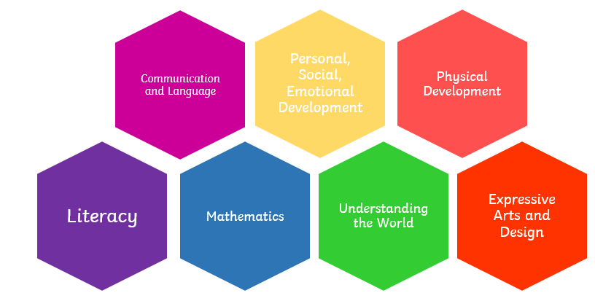
EYFS Statutory Framework
Characteristics of Effective Learning describe behaviours children use in order to learn. To learn well, children must approach opportunities with curiosity, energy and enthusiasm. Effective learning must be meaningful to a child, so that they are able to use what they have learned and apply it in new situations. These abilities and attitudes of strong learners will support them to learn well and make good progress in all the Areas of Learning and Development.
The three characteristics of effective teaching and learning are:
• Playing and exploring – children investigate and experience things, and ‘have a go’.
• Active learning – children concentrate and keep on trying if they encounter difficulties and enjoy achievements.
• Creating and thinking critically – children have and develop their own ideas, make links between ideas, and develop strategies for doing things.
Areas of Learning and Development
Prime areas of development and learning lay vital foundations in the early years. The three prime areas are: CL, PSED and PD. The four specific areas are: L, M, UW, EAD which build on the development gained through the prime areas.

Slide 10

When we give every child the best start in their early years, we give them what they need today. We also set them up with every chance of success tomorrow.
Development Matters [DfE, 2021]

